Slide 1
LINKEDIN INFLUENCERS

Slide 2
HOW TO CHOOSE who TO FOLLOW

Slide 3

Agenda
Topic one
Topic two
Topic three
Topic four

Slide 4



Introduction
LinkedIn is a social networking site that enables registered members especially the business community to connect, share, and learn with other professionals

Slide 5
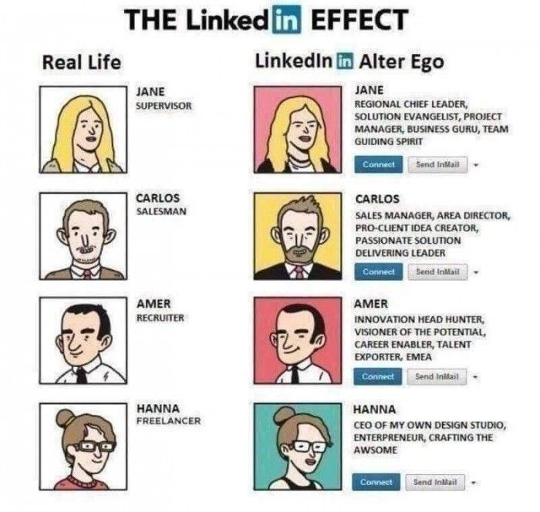

Introduction
LinkedIn Influencers are selected by invitation only and comprise a global collective of 500+ influential

Slide 6
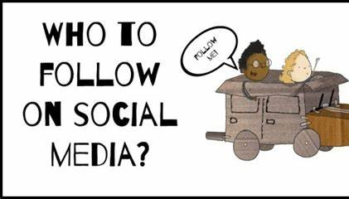
PROBLEM STATEMENT
When using LinkedIn, users may be faced with the challenge of selecting who to follow among the vast number of influencers and professionals present on the platform.
With limited time and attention, it becomes crucial for users to make informed decisions about who to follow in order to enhance their professional growth, gain valuable insights, and build a strong network.
However, the process of selecting the right influencers can be overwhelming and time-consuming, leading to potential missed opportunities or following individuals who may not provide the desired value

Slide 7

Previous studies
Accessing unique perspectives and insights from skilled professionals in today's job market can provide a multitude of benefits, including adaptability, industry knowledge, networking opportunities, problem-solving abilities, and personal development.
While there are a bunch of studies documenting what constitutes a good LinkedIn post and how to ensure engagement and maximum reach for a post, there is limited information/studies about how LinkedIn users choose who to follow.
Users generally follow those who up in their Feed or Use the search function to discover voices on specific topics.

Slide 8
METHODOLOGY

Slide 9
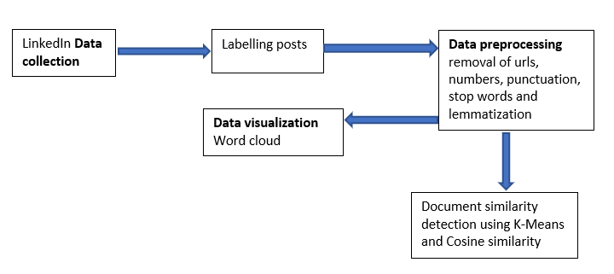

Slide 10
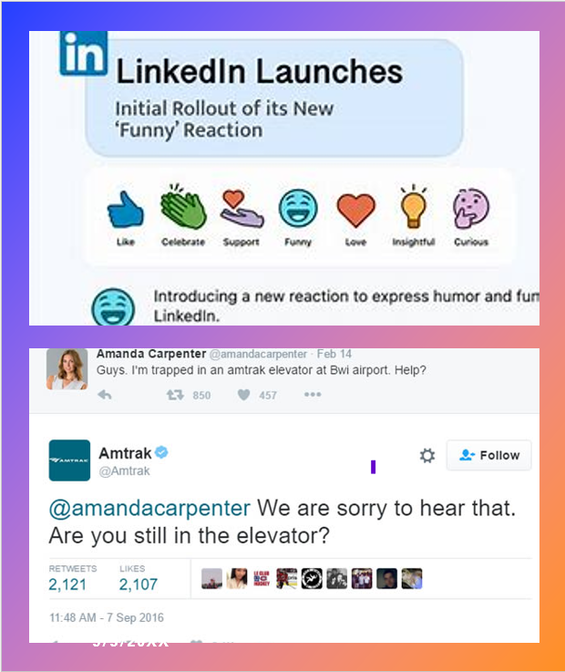
Data collection
LinkedIn data in English downloaded from Kaggle
Sample consists of 31995 posts
Data attributes include the name of the LinkedIn user, the content, number of followers, reactions, comments, number of hashtags etc
Data Pre-Processing
Irrelevant parts of the posts were removed
Tokenization
Stop word removal
Lemmatization
English dictionary-based checking
Data labeling based on reactions and comments
Transform the unstructured data (‘content’ and ‘about’) using the Tfidvectorizer into a Term by document matrix

Slide 11
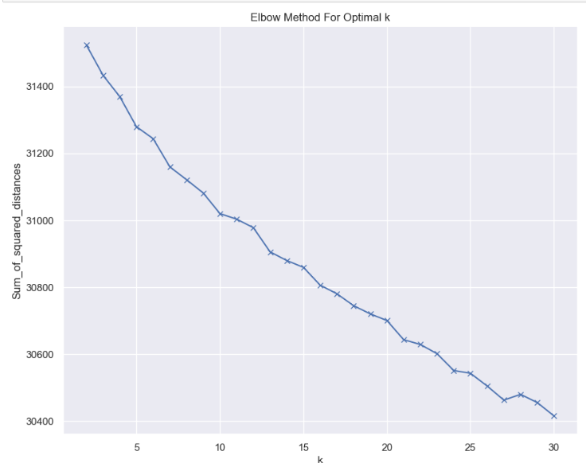
Determining the optimal number of clusters (K)
Notes:
A clear and distinct elbow point is not obvious in the plot. This can happen when the data is inherently complex or does not have well-separated clusters. In such situations, it becomes challenging to determine the ideal number of clusters using the Elbow Method alone. In such cases, you can consider trying other methods to determine the optimal number of clusters: Silhouette Score: The Silhouette Score measures how well each data point fits its assigned cluster compared to other clusters. Higher Silhouette Scores indicate better-defined clusters. You can calculate the Silhouette Score for different numbers of clusters and choose the value that maximizes the score.

Slide 12
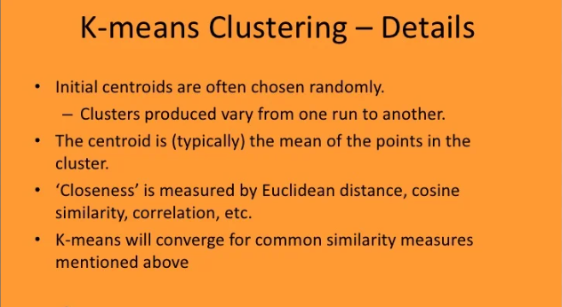

Slide 13
Results

Slide 14
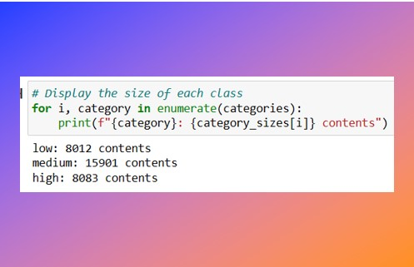
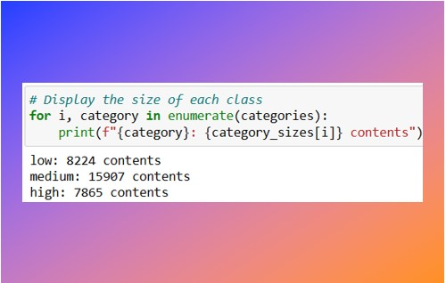
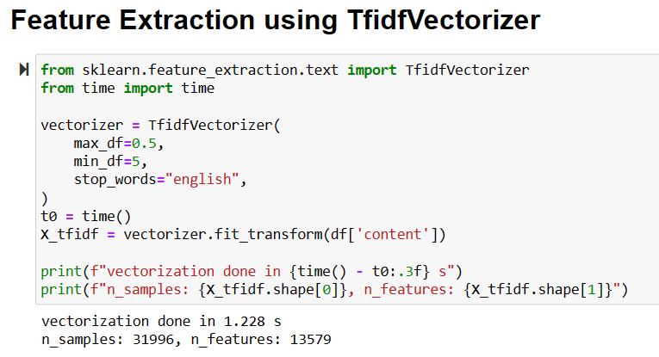
Reaction_class distribution
Comment_class distribution
Notes:
Are posts in the same cluster (same label) similar?

Slide 15
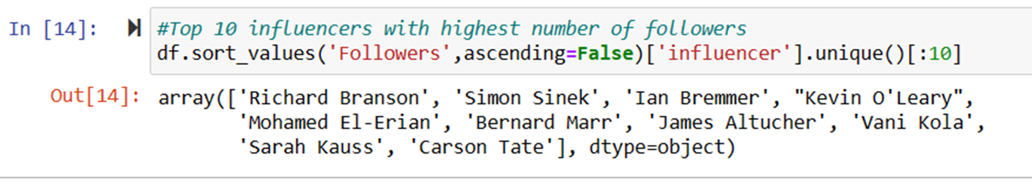
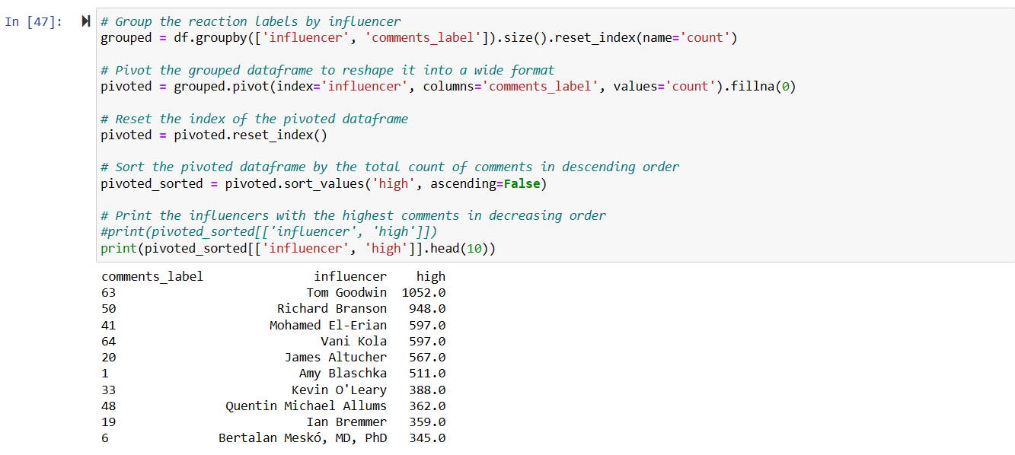
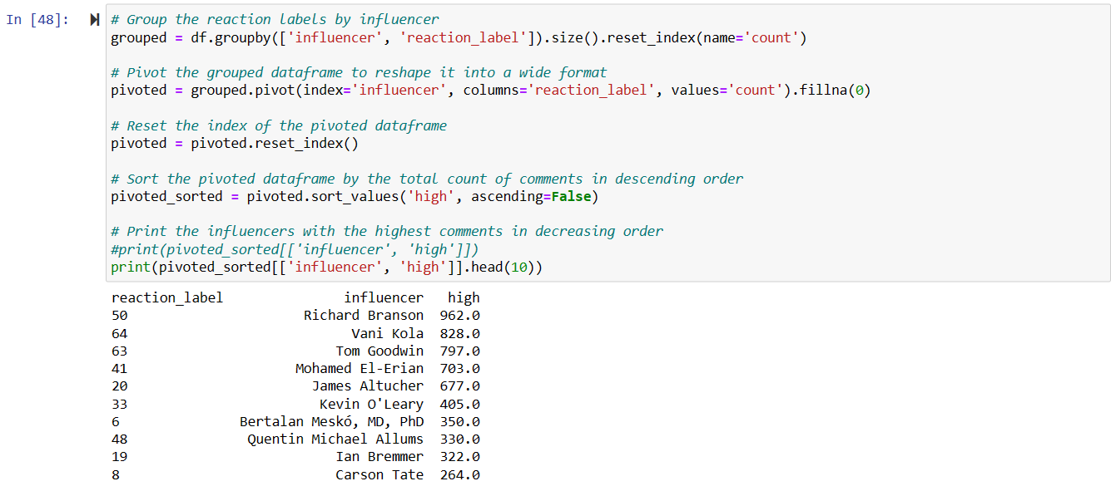

Slide 16
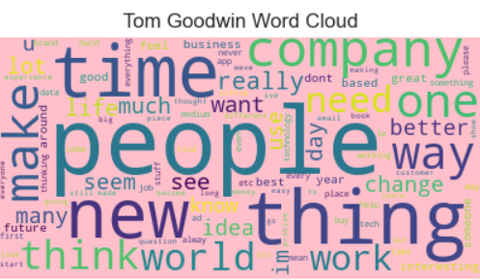
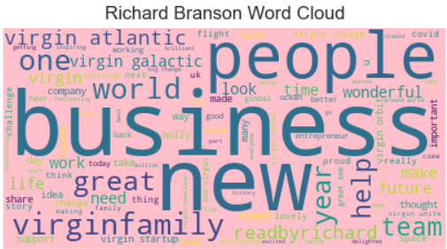
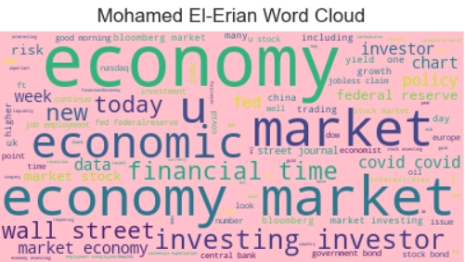
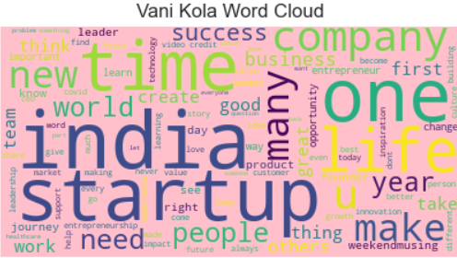
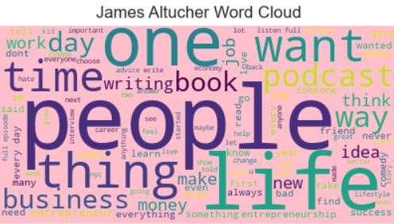
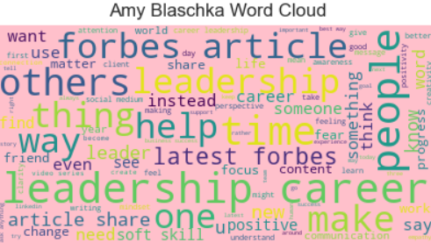
COMMON WORDS IN THE POSTS

Slide 17
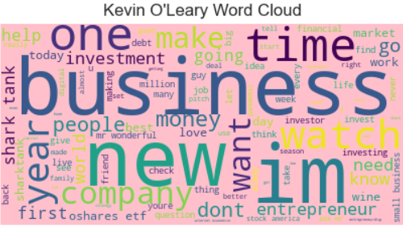
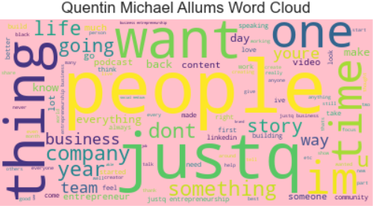
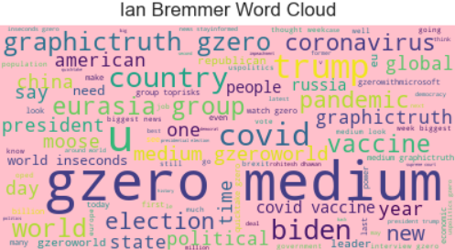
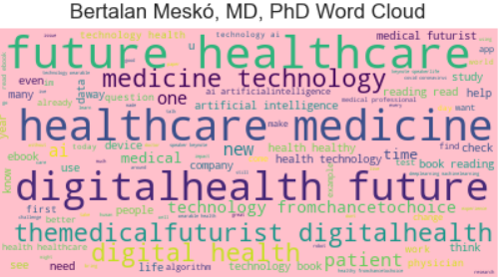
COMMON WORDS IN THE POSTS

Slide 18
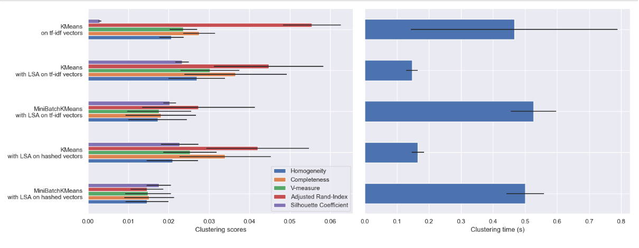
Clustering scores based on reaction classes
Notes:
Kmeans without Dimensionality Reduction
Kmeans with Dimensionality Reduction
Improved Kmeans with Dimensionality
Kmeans with different vector space

Slide 19
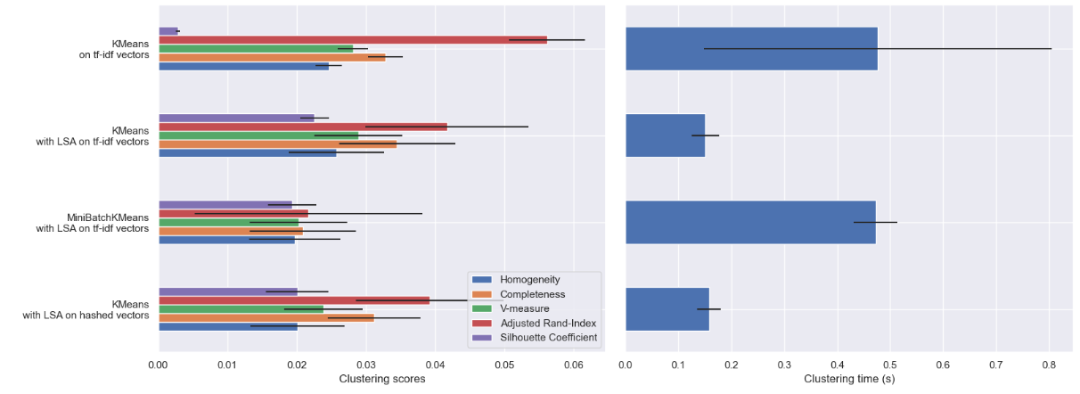
Clustering scores based on comment classes

Slide 20
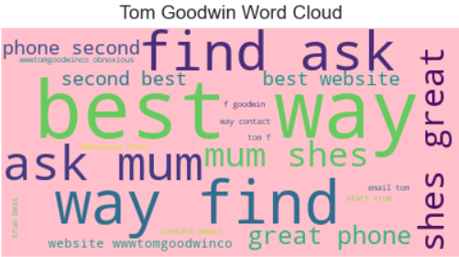
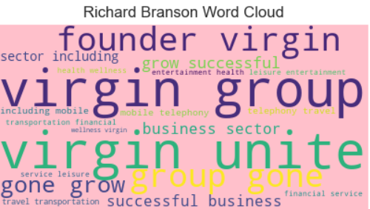
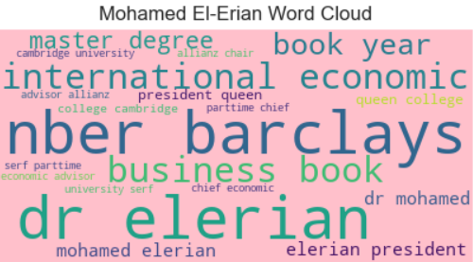
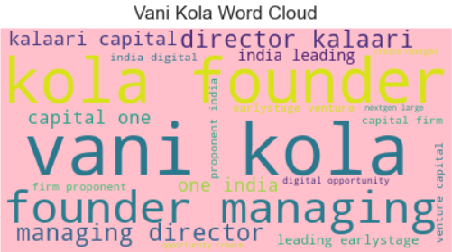
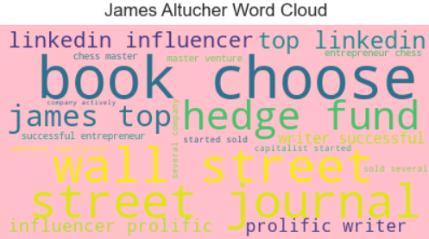
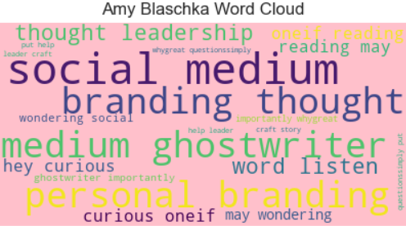
Potential roles

Slide 21
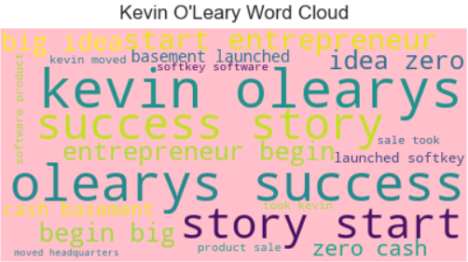
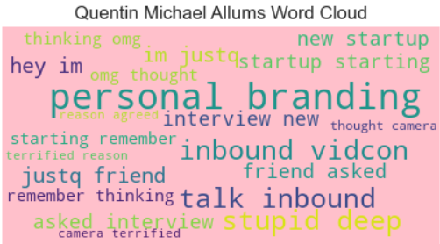
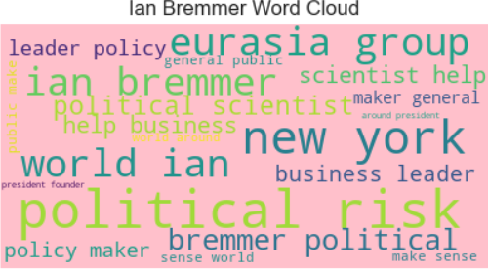
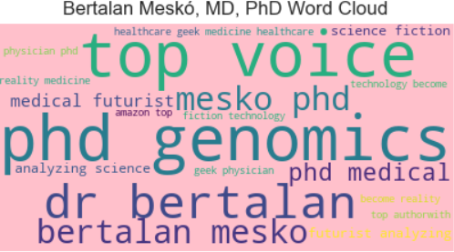
Potential roles

Slide 22



Study Limitations
Timing of the LinkedIn Post
Misclassification of posts
Limited time for the data analysis
Future work
Follow-up analysis could be conducted with a larger dataset as well as considering the timing for the post and additional features such as the use of hashtags in a post
Limited amount of data available

Slide 23
Conclusion

Slide 24




Thank you
Rhoda Nankabirwa

